Slide 1
Deception Detection using Facial Action Units
Emanuele Orfanelli – Sapienza – Laurea Magistrale in Informatica AA. 2017/2018

Slide 2
Introduction
Deception Detection
Many ways to detect lies
FACS
AUs
Architecture
Dataset
Facial Landmarks
Extraction of Features
Action Unit presence/intensity
SVC
Result
Problems
Future
Thanks

Slide 3
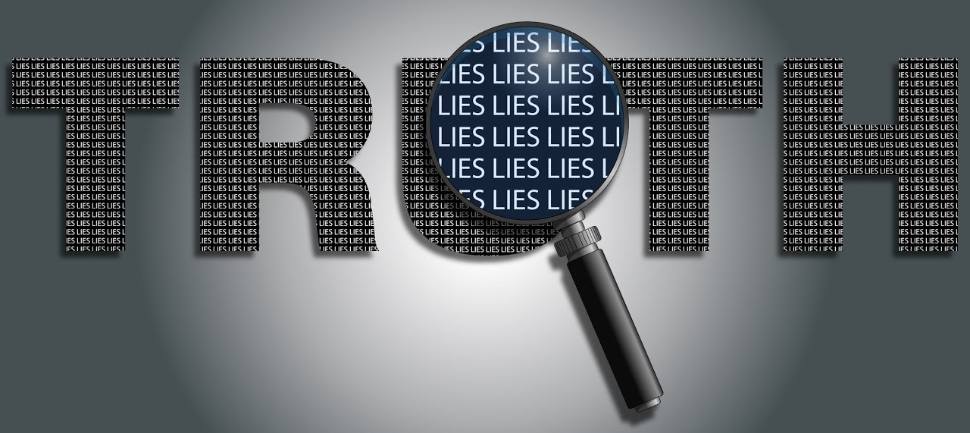
What is Deception Detection?

Slide 4

There are many ways to detect lies
Psychology
Body language, micro-expressions, eye position
Speech analysis
Speed, patterns, words
Neuroscience
EEG, fMRI
Thermal Imaging
More….

Slide 5
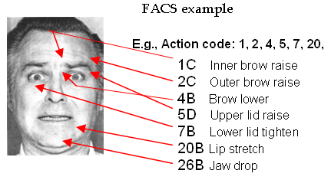
Action Units
Action Units (AU) are a contraction or relaxation of one or more muscles.
AUs can be used to codify emotions through the muscles involved and the intensity of the movement.
Facial Action Coding System manual for such classification.

Slide 6
Facial Action Coding System
Codify all AUs into expressions

Slide 7
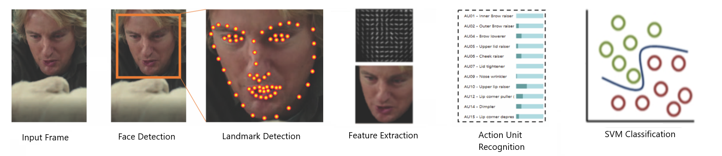
Architecture
Input Video
Face Detection
Landmark Detection
Feature Extraction
AU Recognition
SVM Classification

Slide 8

Video Dataset
Real life trial videos. High stakes.
121 videos.
61 deceptive.
60 truthful.
Defendant or witness can be clearly identified.
Three outcomes to label the videos as deceptive or truthful.
Guilty.
Non-guilty.
Exonerated (reversal of the sentence).
Testimony were verified by police officers.
Work on cutting and removing videos.

Slide 9
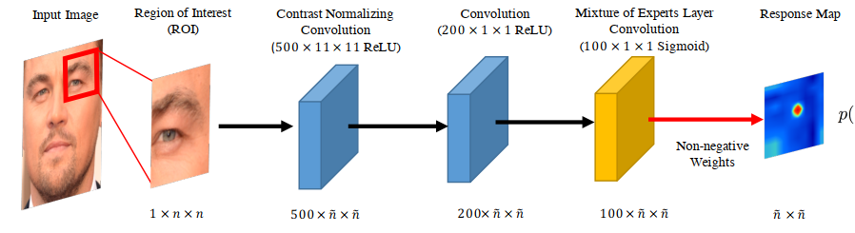
Landmark Detection
Model based approach model both appearance and shape of facial landmarks explicitly with the latter constraining the search space and providing a form of regularization
Local detector: Convolutional Experts Network (CEN).
Convolutional Experts Constrained Local Model (CE-CLM)
Convolutional Experts Network as local detector
Individual landmark alignment is estimated independently of the position of other landmarks.
During the parameter update, the positions of all landmarks are updated jointly and penalized for misaligned landmarks and irregular shapes using a point distribution model
Constrained Local Model for shape parameter update
Two Phases
Response map computation using Convolutional Experts Network
Shape parameter update

